Slide 1
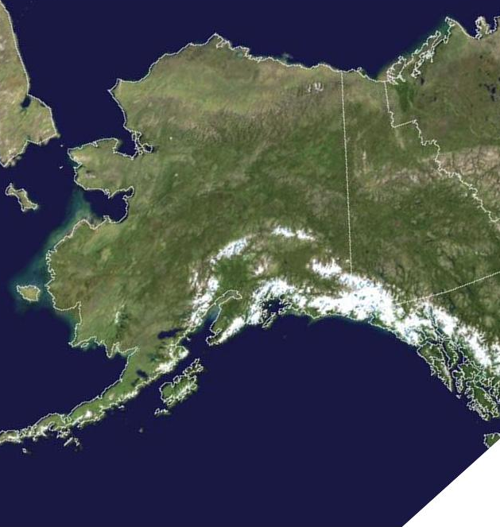




Upper Level Ridge & Breakdown
This pattern brings the most lightning ignitions to Alaska!
L
Starts with an upper level ridge over Canada that pushes into Alaska
H
Pattern lasts for several days while wind & sun dry fuels
Ridge begins to weaken, allowing instability (TSTMS) around edges.
L
Therefore,
RIDGE BREAKDOWN
is a
critical fire weather pattern
As the ridge breaks down & moves east, lightning ignitions & dry fuels create many fire starts.

Slide 2
Upper Level Ridge & Breakdown
H
This is how the 500 mb chart will appear for this pattern.
L

Slide 3

Southerly Flow
(Chinook)
This pattern brings dry conditions and strong winds to the north side of Alaska’s many mountain ranges!
L
High pressure builds in directly from south
This creates:
- Strong winds (Chinook)
- Rain along coast
- Dry fuels on the north sides of mountain ranges
Therefore,
Southerly Flow
is a
critical fire weather pattern
Any ignitions will have rapid development due to winds and dry fuels.
H

Slide 4
Southerly Flow
(Chinook)
H
This is how the 500 mb chart will appear for this pattern.

Slide 5
Northerly Winds
This pattern brings cool, dry winds to all of Alaska, drying fuels despite colder temperatures!
L
H
High pressure builds to west and low pressure over Canada
May also occur if high shifts to north and low to south
Either pattern creates:
- Dry winds from north
- Clear skies
- Low temperature & RH
Therefore,
Northerly Flow
can be a
critical fire weather pattern
With strong winds, this can increase fire danger across much of the state.

Slide 6
Northerly Winds
L
H
This is how the 500 mb chart may appear for this pattern.
This is an alternative appearance for the 500 mb chart for this pattern.

Slide 7
Backdoor Precip
This pattern may bring significant amounts of rain to the Eastern and Central Interior…or not!
There is a well-stacked closed low near Yakutat.
The low moves north, often repositioning in the Copper River Basin
Southeast flow comes from Gulf of AK, through Canada
L
This brings rain into the upper Tanana and Yukon Valleys, dousing local fires.
Therefore,
Backdoor Precip
can be a
season-slowing event
Extent of precipitation is difficult to predict.

Slide 8
Backdoor Precip
This is how the 500 mb chart will appear for this pattern.
L

Slide 9
Southwesterly Flow
Wettest pattern for most of Alaska, this flow signals the end of our fire season.
A flat ridge of high pressure builds into the Gulf of AK
The upper level flow brings in moisture parallel to the Alaska Range.
  This brings clouds & rain into the dry interior, even to the ALCAN border.
H
Extensive moisture extinguishes most fires.
Therefore,
Southwesterly Flow
can be a
season-ending event
Copper River Basin may be protected: takes longer duration to douse fires.

Slide 10
Southwesterly Flow
This is how the 500 mb chart will appear for this pattern.
H

